Slide 1
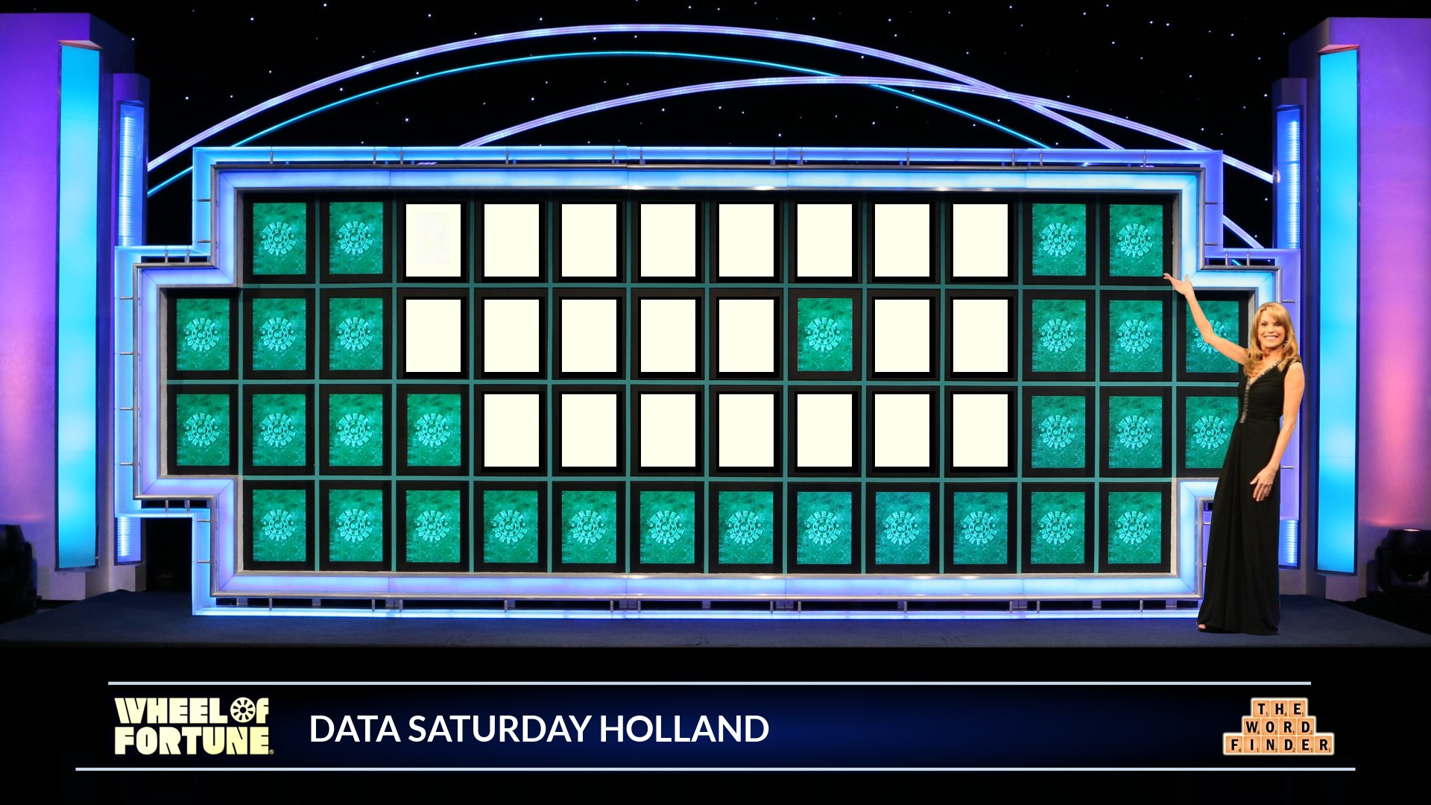

Slide 2
D
B
A
T
O
O
L
S
W
H
E
E
L
O
F
F
O
R
T
U
N
E

Slide 3
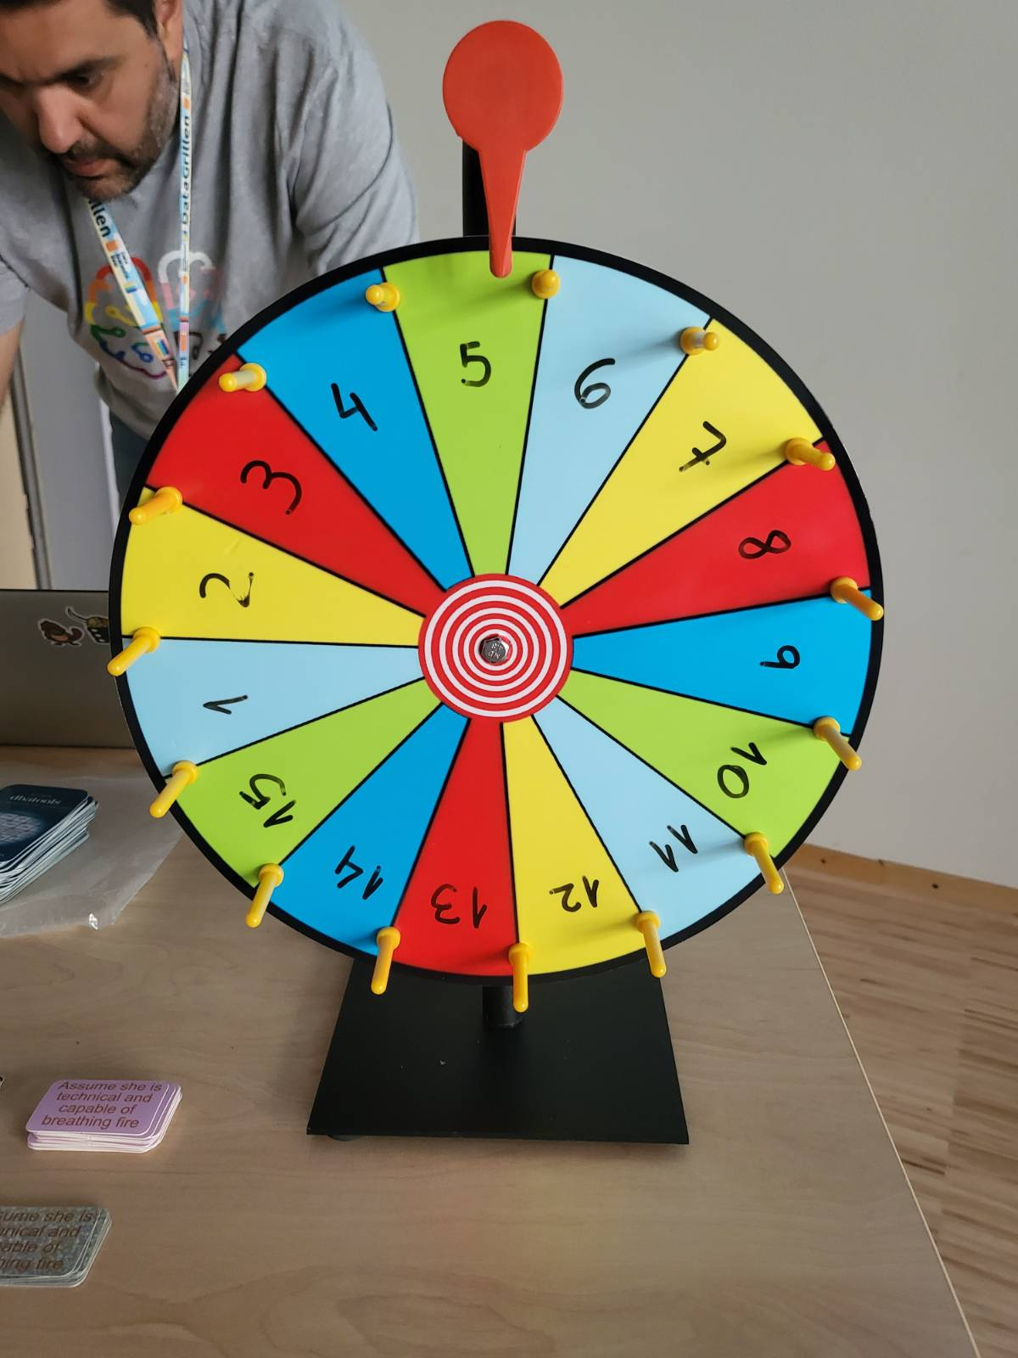
Funny Story….
We did have a proper wheel…

Slide 4
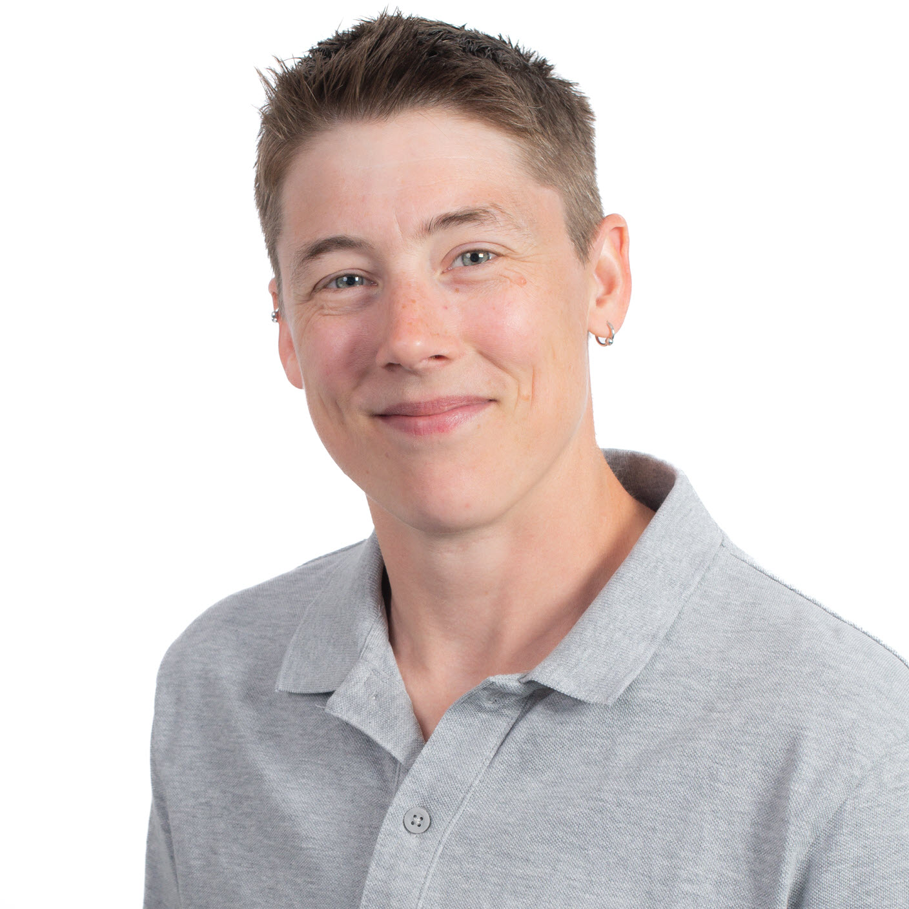


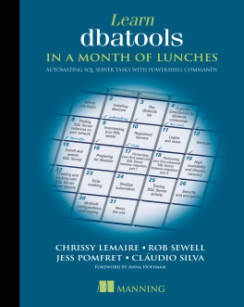





Jess Pomfret
(She/Her)
What do I do?
Database Administration
Automation
Open-Source Contributor
dbatools
dbachecks
jpomfret
jesspomfret.com
jpomfret

Slide 5

Cláudio Silva
(He / Him)
What do I do?
Performance Tuning
Automation
Open-Source Contributor
dbatools
dbachecks
claudioessilva
claudioessilva.eu
claudioessilva

Slide 6









Thank you sponsors!
ata Saturdays

Slide 7
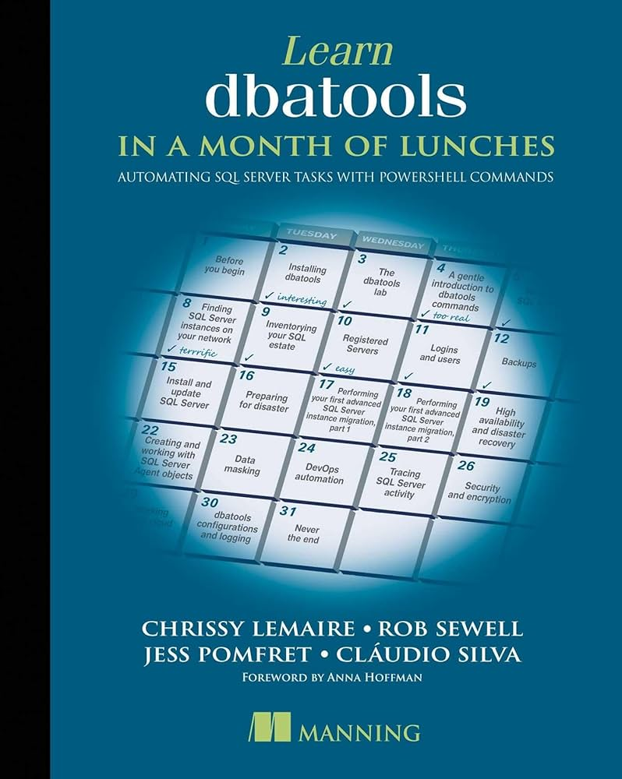
THE AWESOME DBATOOLS
694 commands and counting
Build and managed by Data Professionals
Signed module (security matters)
GitHub (dbatools.io/github)
(Please open “issues”/”feature requests”)
PowerShell gallery
Slack (dbatools.io/slack)
The book (dbatools.io/book)

Slide 8
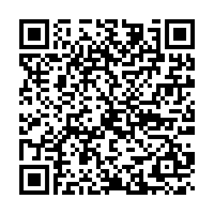
Rate This session

Slide 9
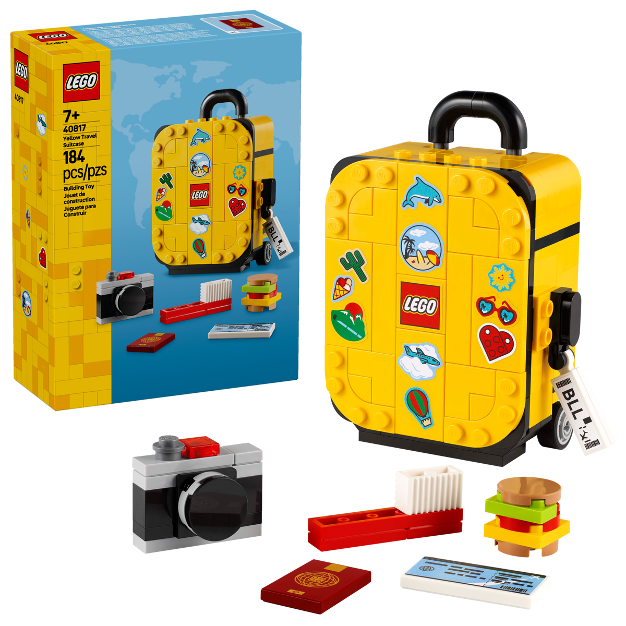
Rate Data Saturday Holland
Review to win With custom Data Saturdays lego stickers!

